Slide 1

B.Tech Project Evaluation, VIIIth Sem
Fake News Detection Using Blockchain
Presented by :-
Taslim Raza Ahmad (2019635844)
Veetu Kaushik(2019521381)
Jai Sanger (2019786458)
Under the Supervision of:-
Dr. Renu Mishra
Associate Professor
DEPARTMENT OF COMPUTER SCIENCE & ENGINEERING
SCHOOL OF ENGINEERING AND TECHNOLOGY

Slide 2

Approval

Slide 3
Content
Introduction
Motivation and Problem Defination
Existing System
Proposed System
Implementation
Result and analysis
Conclusion
Reference

Slide 4
Introduction
Social media network is one of the important parts of human life based on the recent technologies and developments in terms of computer science area. This environment has become a famous platform for sharing information and news on any topics and daily reports, which is the main era for collecting data and data transmission. There are various advantages of this environment, but in another point of view there are lots of fake news and information that mislead the reader and user for the information needed. Lack of trust-able information and real news of social media information is one of the huge problems of this system.

Slide 5
Motivation and Problem Defination
Fake news is a growing problem that can have serious consequences. Combining blockchain and deep learning technologies can create a secure and reliable system for detecting fake news. Blockchain can establish the authenticity and provenance of news articles, while deep learning algorithms can identify patterns and features common to fake news. This can lead to a more reliable and transparent system for online journalism, and help restore trust and accuracy to online news sources .

Slide 6
Existing Problem
Author Name | Advantages | Disadvantages | Methodology
Nicollas R. [2] | computational expressive examination in light of NLP | It has 86% exactness and 94% accuracy | It Uses NLP and ML Calculations for calculating the exactness of the report.
Guanfeng Liu, [3] | idea of Quality of Trust (QoT) is used to show the level of reliability | better but not 100% accurate. | Monte Carlo-based estimate calculation.
Maria Nefeli Nikiforos, [4] | gives a spic and span informational index of 2,366 English- tweets | Covers only particular event not all and still in Research stage | Two ML models were utilized in preliminaries
Adline Rajasenah [5] | different exemplary ML and deep learning systems | better than the other wokrs but not 100% accurate. | This research is completely based on deep learning models.
Xishuang Dong [6] | This paper is also effective even with limited labeled data. | very limited labeled data is available, which is inadequate for the supervised model | proposed a deep semisupervised learning model of limited labeled data.

Slide 7
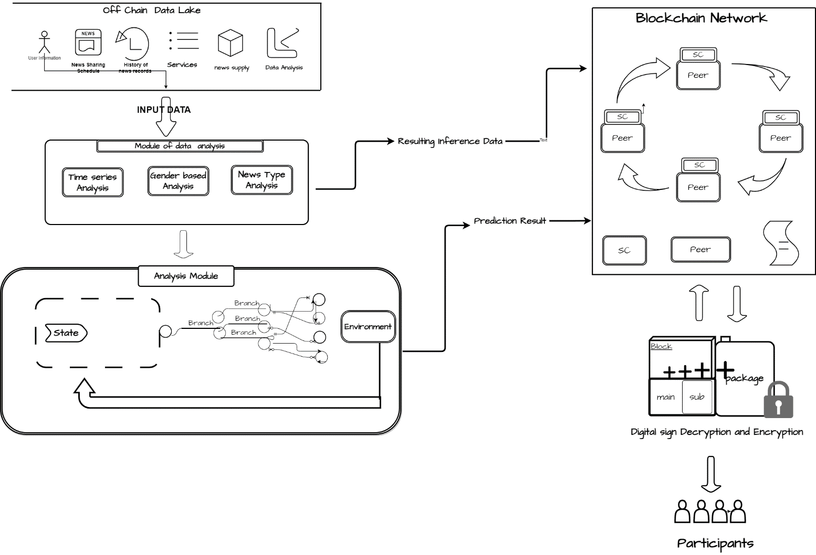
PROPOSED SYSTEM

Slide 8
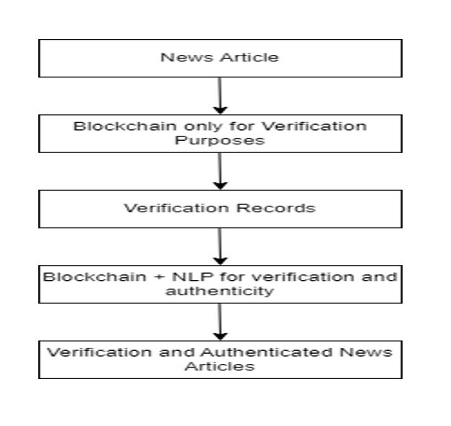

Slide 9
IMPLEMENTATION
Software Requirement -1)Visual Studio Community Version
2)Nodejs ( Version 12.3.1)
3)Python IDEL ( Python 3.7 )
Hardware Requirement –1)Operating System(Windows11)
2)Processor and Ram(I5, 4gb)
3)Hard Disk(50gb)

Slide 10


Slide 11
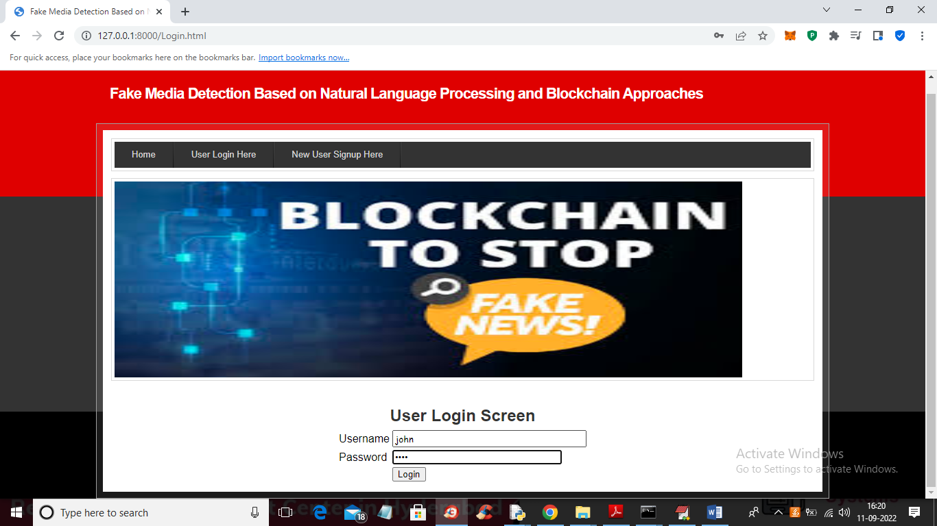

Slide 12
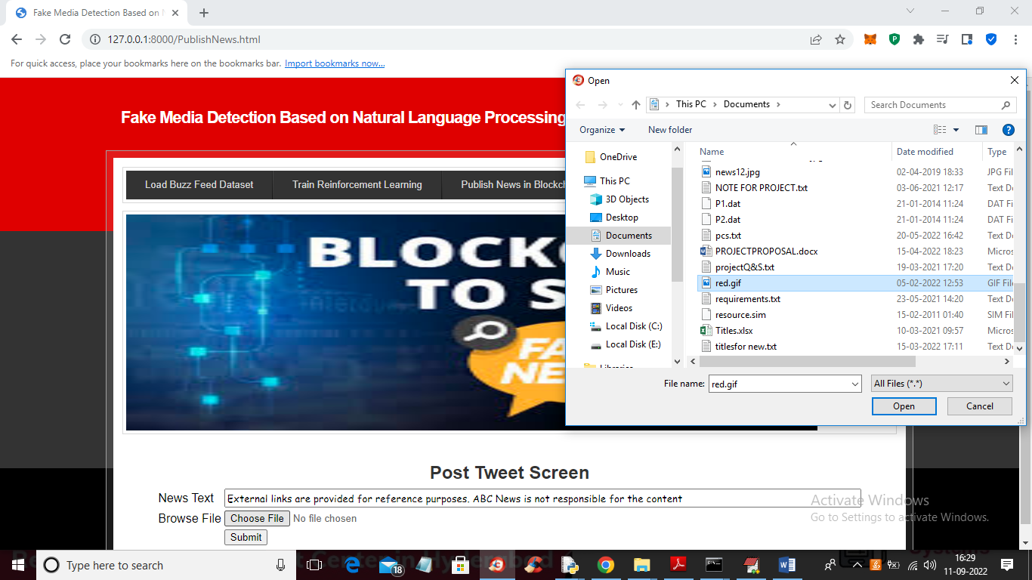

Slide 13
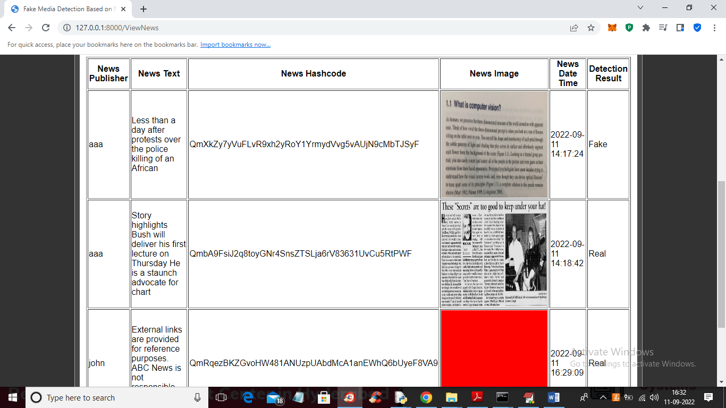

Slide 14
Result and analysis
Using only blockchain for fake news detection would involve creating a blockchain-based system where news articles are stored and verified through cryptographic algorithms. While this would provide a reliable record of the publication of a news article, it would not necessarily determine the authenticity of its content.On the other hand, using blockchain with NLP would involve combining the two technologies to verify both the publication of news articles and the accuracy of their content. NLP algorithms could be used to analyze the language and sentiment of news articles to determine their authenticity, while blockchain could provide a secure and immutable record of the verification process.
In summary, while blockchain can provide a secure and reliable way to verify the publication of news articles, using NLP in combination with blockchain can help to determine the authenticity of their content.

Slide 15
Conclusion
Fake news spread is one of the most well-known concentrate on points in present day innovation, inferable from an absence of safety and trust in the veracity of data distributed via virtual entertainment. Here, we offered arrangements and fostered a trust-based engineering for online news sharing utilizing a blend of blockchain and ML techniques. We joined a blockchain structure, shrewd agreements, and a custom agreement calculation that is great for the Evidence of-Authority convention with the support learning approach, a learning-based calculation, to make a powerful dynamic design. In this cycle, virtual entertainment is pivotal. The Evidence of-Authority convention and client approval face a critical test given that the common data stage contains fake news.

Slide 16
Links
Github Link
https://github.com/Taslim932/FakeNewsDetection
Conference Link
https://conferences.lpu.in/iccs/
https://vitbhopal.ac.in/icetcia/

Slide 17
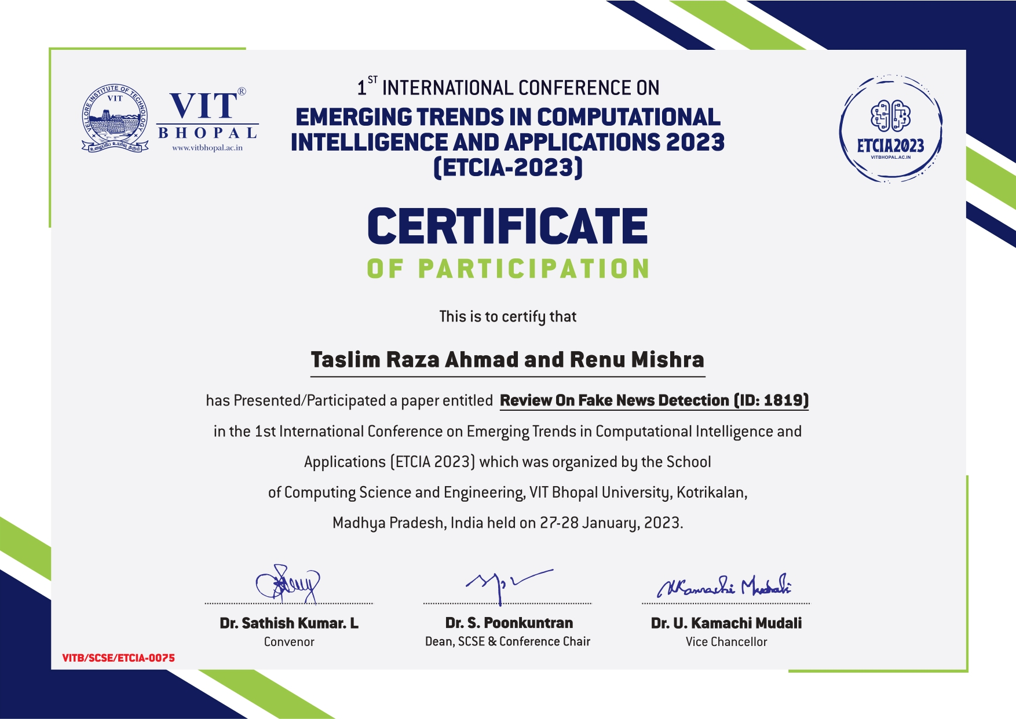
7th Semester

Slide 18
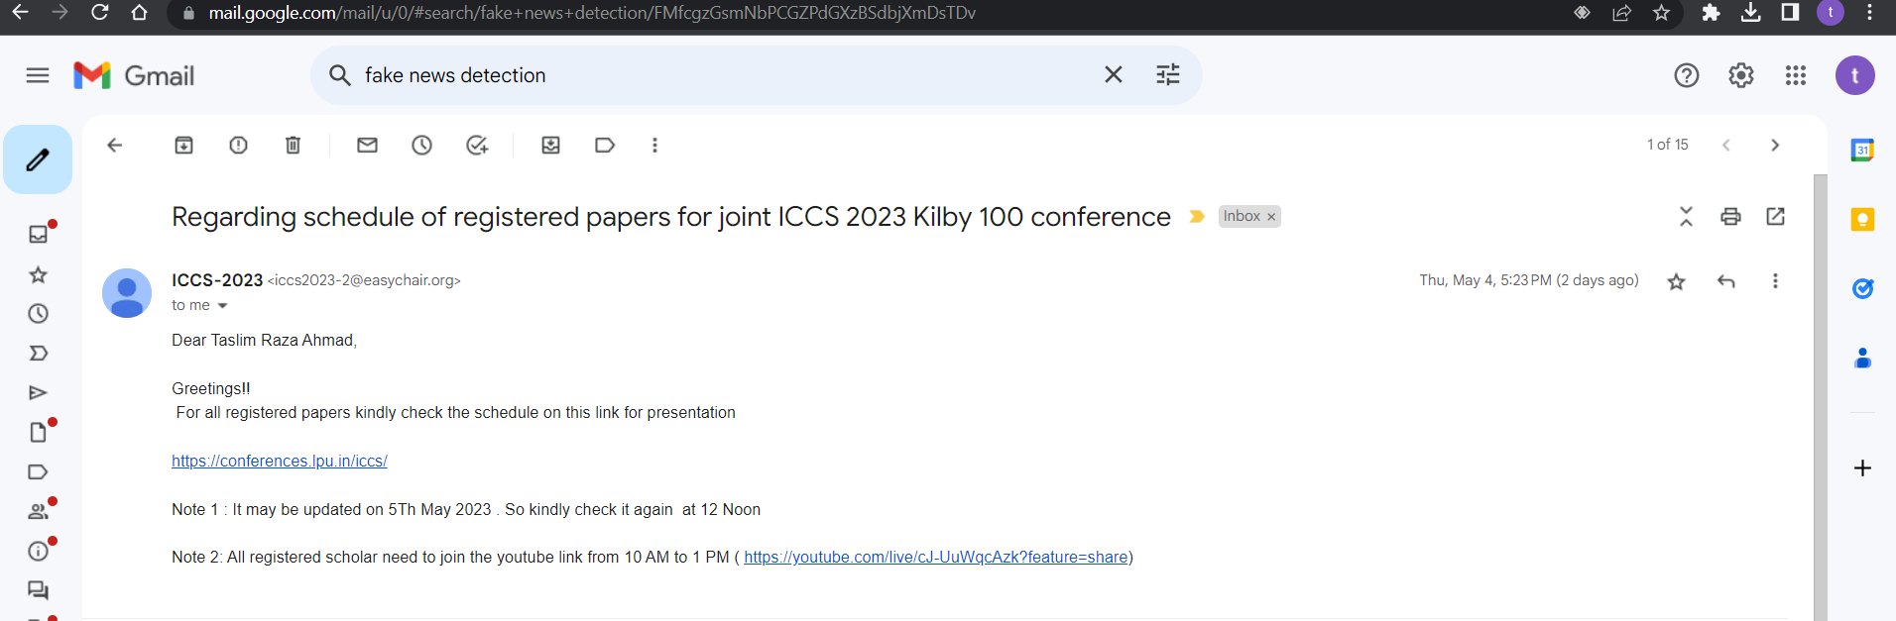
8th Semester

Slide 19


Slide 20
References
[1] V. P. Miletskiy, D. N. Cherezov, and E. V. Strogetskaya, ‘‘Transformations of professional political communications in the digital society (by the example of the fake news communication strategy),’’ in Proc. Commun. Strategies Digit. Soc. Workshop (ComSDS), 2019, pp. 121–124.
[2] N. R. de Oliveira, D. S. V. Medeiros, and D. M. F. Mattos, ‘‘A sensitive stylistic approach to identify fake news on social networking,’’ IEEE Signal Process. Lett., vol. 27, pp. 1250–1254, 2020.
[3] G. Liu, Y. Wang, and M. Orgun, ‘‘Optimal social trust path selection in complex social networks,’’ in Proc. AAAI Conf. Artif. Intell., vol. 24, 2010, pp. 1391–1398.
[4] M. N. Nikiforos, S. Vergis, A. Stylidou, N. Augoustis, K. L. Kermanidis, and M. Maragoudakis, ‘‘Fake news detection regarding the Hong Kong events from tweets,’’ in Proc. Int. Conf. Artif. Intell. Appl. Innov. Greece: Springer, 2020, pp. 177–186.
[5] A. R. Merryton and G. Augasta, ‘‘A survey on recent advances in machine learning techniques for fake news detection,’’ Test Eng. Manag, vol. 83, pp. 11572–11582, 2020.

Slide 21
THANK YOU

